Slide 1

Copyrights vs copyleft Open source vs Free Software Foss License
By Vipul & Ankit

Slide 2

Copy Right
Copyright is the right that enable you to prevent unauthorized copying or selling of your work.
In others words
Copyright (or author's right) is a legal term used to describe the rights that creators have over their literary and artistic works.
Works covered by copyright range from books, music, paintings, sculpture, and films, to computer programs, databases, advertisements, maps, and technical drawings.

Slide 3
Copy left
Copyleft is a general method for making a program free and requiring all modified and extended versions of the program to be free as well. The simplest way to make a program free software is to put it in the public domain, uncopyrighted.
Example:
Copyleft originally made for the infamous Linux OS (logos of GNU and Linux above)
It is now widely used to Copyleft software such as Mozilla Firefox, Java, and OpenOffice

Slide 4
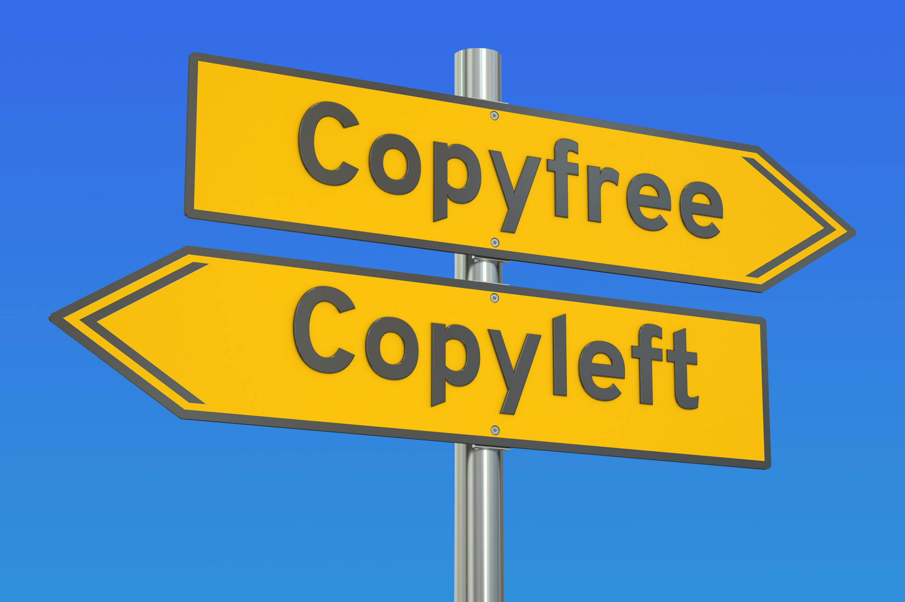
Difference between Copyright and Copyleft
Copyright
Copyleft
Copyright is the right that enable you to prevent unauthorized copying or selling of your work.
The work is original and not the copy of other.
Copyrights protects you original ideas from others access.
Whereas Copyleft is a method using which you can modify the software or documentation and distribute it back to the open-source community.
Copyleft comes with an idea of collaboration.
While Copyleft allows you to make changes to other ideas and give them back.

Slide 5
Difference between Copyright and Copyleft
Copyright
Copyleft
Copyright is all about granting individual permission.
You can apply Copyright protection both to work that you have published into the public domain and work that you have not published.
It is denoted by ©
Copyleft is all about user freedom.
While Copyleft allows users to distribute derivative works under a license that offers the same rights as the original work.
It is denoted by mirror image of copyright symbol.

Slide 6
Difference between Copyright and Copyleft
Copyright
Copyleft
Examples of Copyright: Suppose you made a movie, now if anyone else wants to make its sequel, he has to buy copyright from you.
Examples of Copyleft: Red Hat Enterprise Linux is a good practical example of copyleft. Which is a commercial operating system. Users are free to modify and redistribute the source code but they are not allowed to resell it.

Slide 7

History of Open Source
The idea of making source code freely available originated in 1983 from an ideological movement informally founded by Richard Stallman, a programmer at MIT.
Stallman believed that software should be accessible to programmers so they could modify it as they wished, with the goal of understanding it, learning about it, and improving it.
Stallman began releasing free code under his own license, called the GNU Public License.
This new approach and ideology surrounding software creation took hold and eventually led to the formation of the Open Source Initiative in 1998.

Slide 8
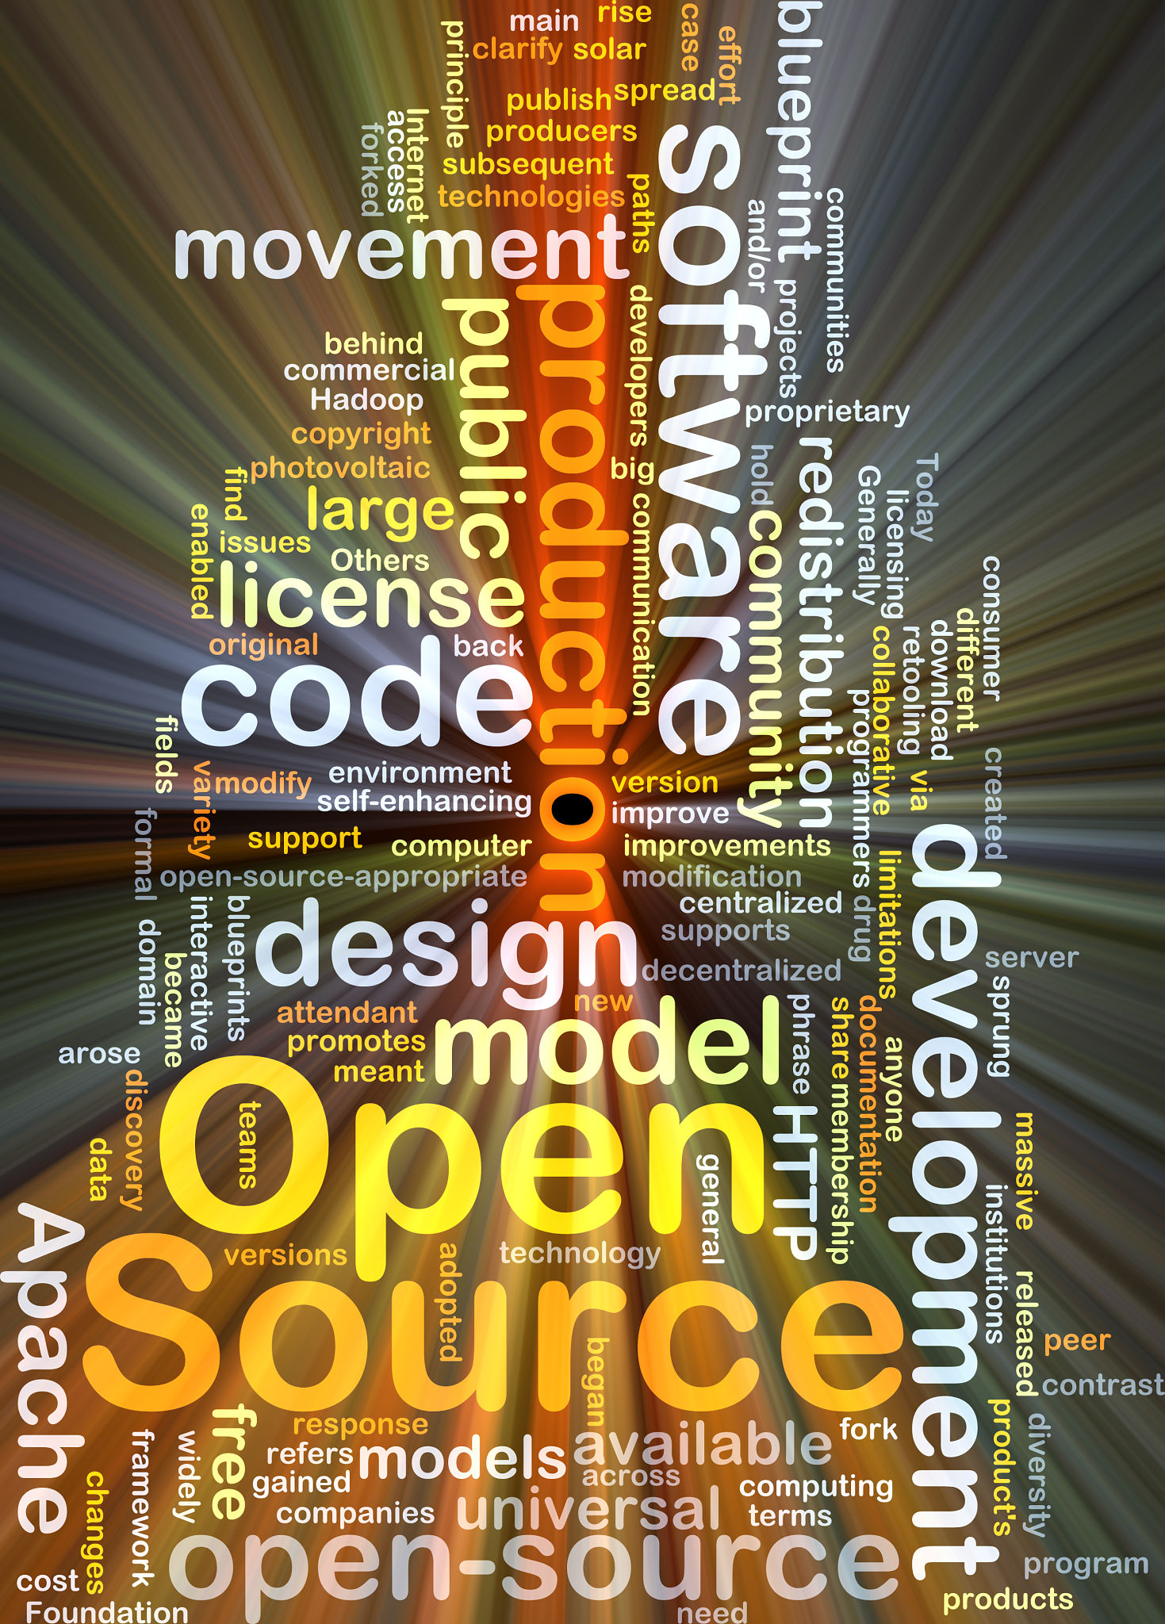
Open Source
Open source is a term that originally referred to open source software (OSS). Open source software is code that is designed to be publicly accessible—anyone can see, modify, and distribute the code as they see fit.
Programmers who have access to source code can change a program by adding to it, changing it, or fixing parts of it that aren’t working properly.
Examples: GNU/Linux, Mozilla Firefox, VLC media player, SugarCRM, GIMP, VNC, Apache web server, LibreOffice, jQuery

Slide 9
Free Source
it means that the users have the freedom to run, copy, distribute, study, change and improve the software.
Some of the best-known examples include the Linux kernel, the BSD and Linux operating systems, the GNU Compiler Collection and C library; the MySQL relational database; the Apache web server; and the Send mail mail transport agent.

Slide 10
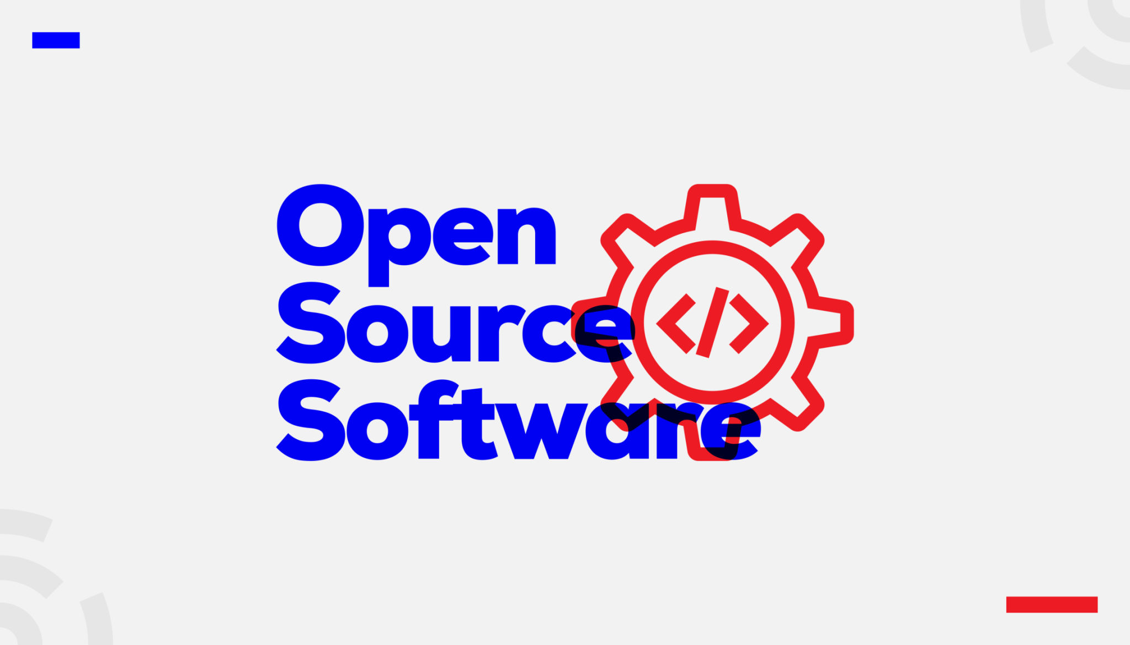
Four Essential Freedoms of Free Software
The freedom to run the program as you wish, for any purpose (freedom 0).
The freedom to study how the program works, and change it so it does your computing as you wish (freedom 1).
The freedom to redistribute copies so you can help your neighbor (freedom 2).
The freedom to distribute copies of your modified versions to others (freedom 3). By doing this you can give the whole community a chance to benefit from your changes.
Freedoms 1 and 3 require source code to be available because studying and modifying software without its source code is highly impractical.

Slide 11

FOSS
Free and open-source software (FOSS) allows users and programmers to edit, modify or reuse the software's source code. This gives developers the opportunity to improve program functionality by modifying it. The term “free” indicates that the software does not have constraints on copyrights.

Slide 12

GNU
GNU is an operating system that is free software—that is, it respects users' freedom. The GNU operating system consists of GNU packages (programs specifically released by the GNU Project) as well as free software released by third parties. The development of GNU made it possible to use a computer without software that would trample your freedom
Four requirements of being the free software if given by the GNU team

Slide 13
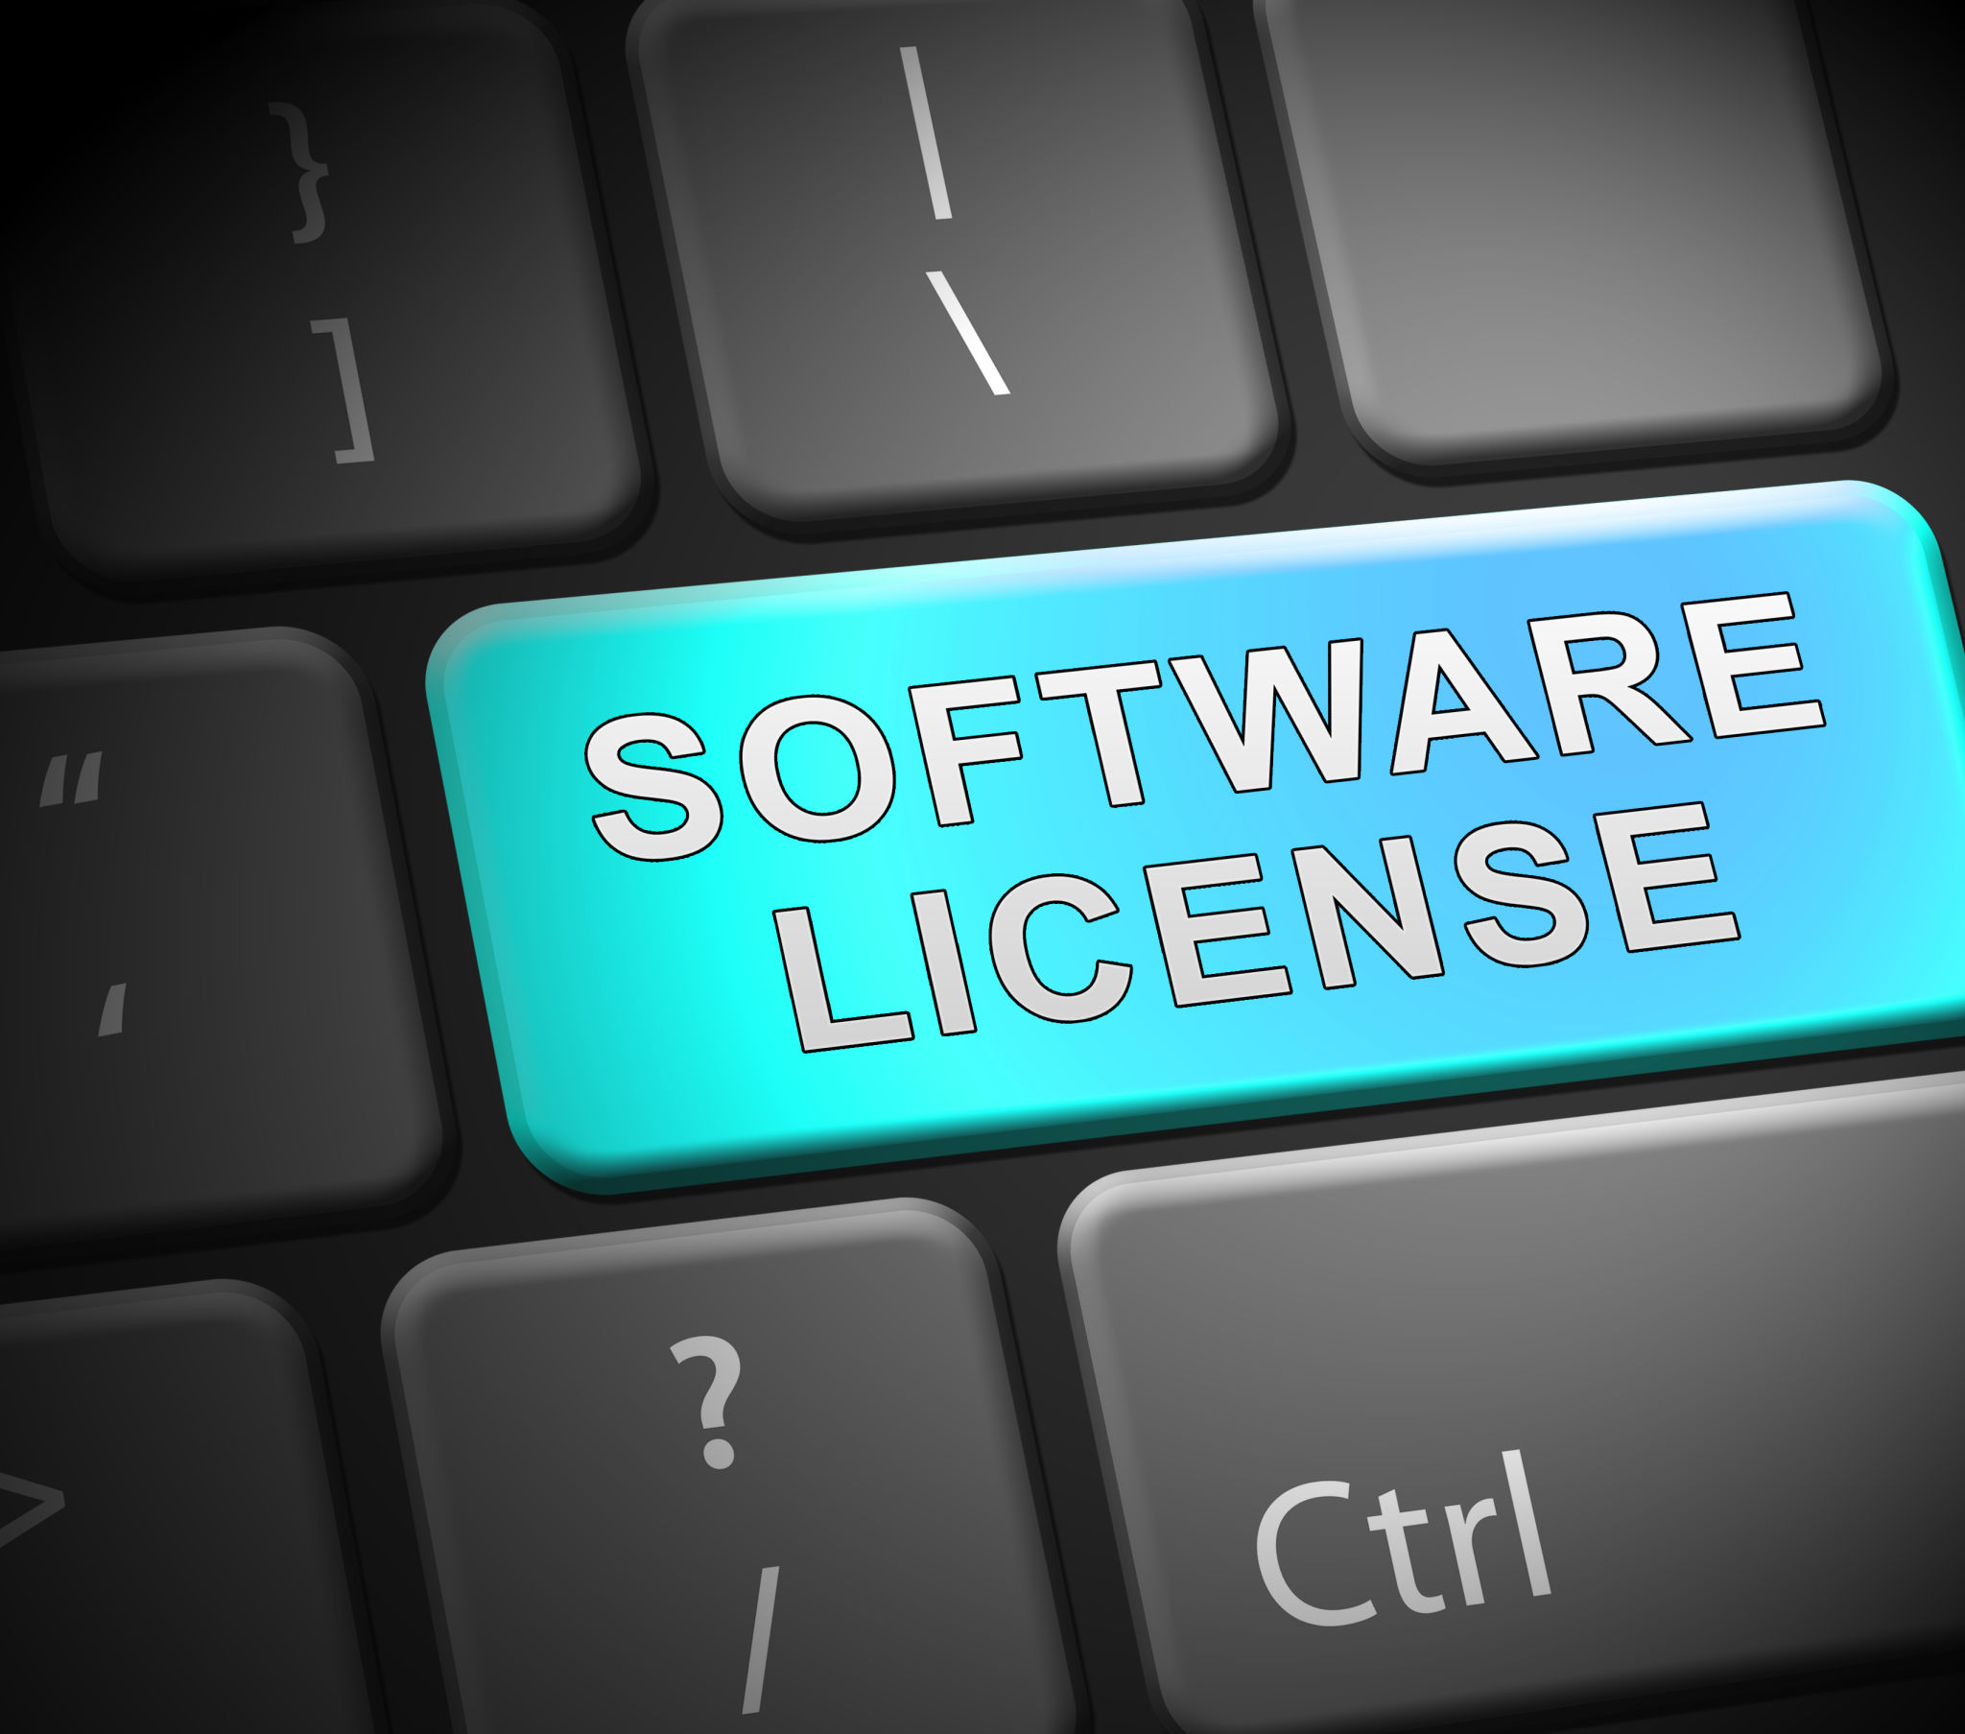
FOSS Licenses
There are a lot of licenses available over the internet.
Apace
BSD
GPL
LGPL

Slide 14

Apache License
It provides the ability to use the software for commercial purposes.
It provides the ability to modify the software and create derivatives.
It provides the ability to distribute original or modified (derivative) works.
It provides the ability for you to grant/extend a license to the software.
It provides the ability to use/modify software freely without distributing it. It provides the ability to place warranty on the software licensed.
Hold liable
Use trademark
Important to include these things:
Include copyright
Include license
State changes
Include notice

Slide 15

BSD License
Rules for the using BSD licensed project
1. Redistributions of source code must retain the above copyright notice, this list of conditions and the following disclaimer.
2. Redistributions in binary form must reproduce the above copyright notice, this list of conditions and the following disclaimer in the documentation and/or other materials provided with the distribution.
3. Neither the name of the copyright holder nor the names of its contributors may be used to endorse or promote products derived from this software without specific prior written permission.

Slide 16

GPL License
Include a copy of the full license text
State all significant changes made to the original software
Make available the original source code when you distribute any binaries based on the licensed work
Include a copy of the original copyright notice
GPL requires you to release the source code of your application if you choose to use and distribute the GPL licensed open source software with your application. In other words, your application must also be licensed under the GPL.

Slide 17
L-GPL License
LGPL allows you to use and distribute the open source software with your application without releasing the source code for your application.
Other developers can borrow and modify the code and re-distribute it as part of their own project, provided that the portion used under the LGPL, including any modifications, is re-licensed under the LGPL. Other portions of the project are permitted have other licenses.

